Slide 1
Digital Signal Processing
Lecture-5
Presented By: Dr. Kiran Khurshid

Slide 2
Stable or unstable system
A system is said to be stable if every bounded input produces a bounded output.
A bounded signal is one whose magnitude is always a finite value.
Example: sine wave

Slide 3
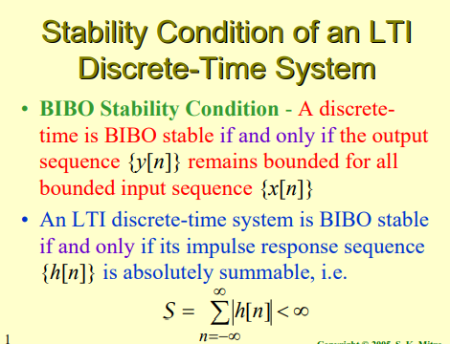

Slide 4
Stable or unstable system
h(n)= 0.2 ^{n} u(n)
h(n)= 4 ^{n} u(-n)
Y(n)= e ^{–x(n)}
y(n)= x(n) + ½ x(n-1) + ¼ x(n-2)
Causal or non-causal system
Y(n)= x(n) – x(-n-1) + x(n-1) ?

Slide 5
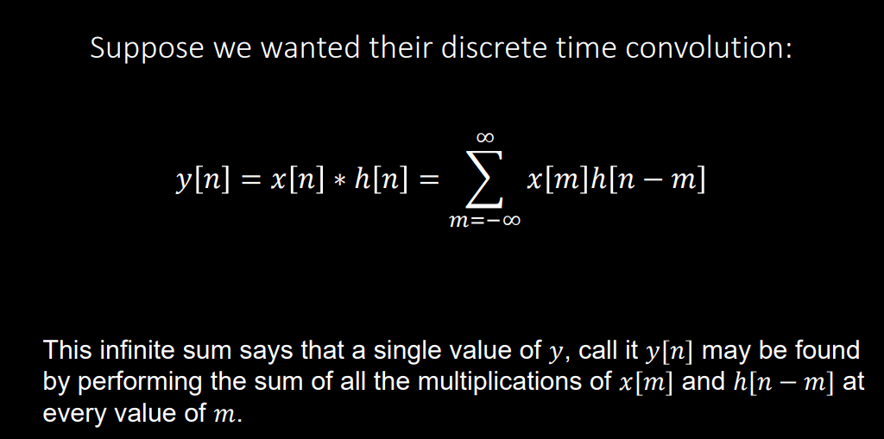
Convolution (Linear/ Discrete Convolution)

Slide 6
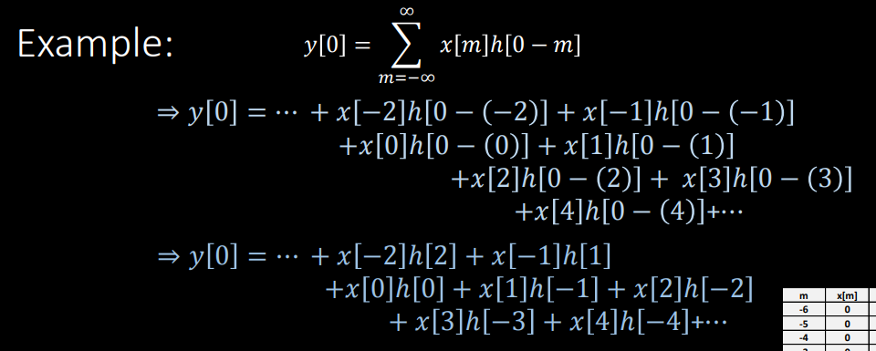


Slide 7
Points to remember:
Convolution x3(n)= x1(n)*x2(n)
If number of samples of x1(n) = N1, x2(n)= N2, then x3(n)= N1+N2-1
If x1(n) starts at n1 and x2(n) at n2, then x3(n) starts at ? n1+n2
^{Ends at n1+n2 + (N1+N2-1)-1}
^{For causal system, h(n)=0, n<0}
^{For causal input, x(n)=0, n <0}
^{1) h(n)= anu(n), x(n)=bnu(n)}
2) x(n)= cos𝜋n u(n), h(n)=(1/2)nu(n)

Slide 8
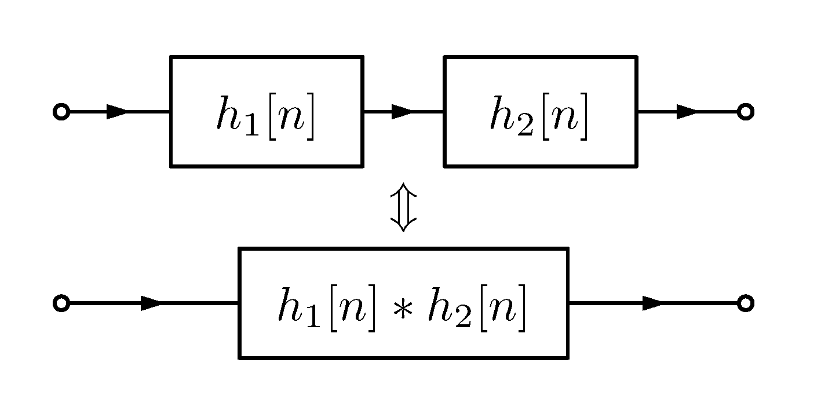
Interconnection of discrete time systems
Cascade and parallel connections

Slide 9
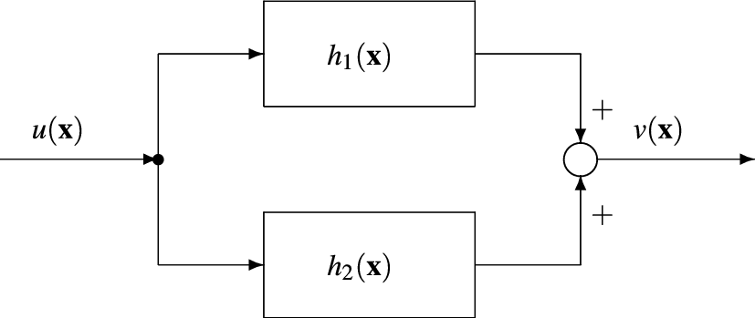

Slide 10
Determine the impulse response for the cascaded connection
h1(n)= (2/5)nu(n), h2(n)=(1/5)nu(n)

Slide 11
Determine the response of the system
x(n)= {1,2,0.5,1}
↑
h(n)={1,2,1,-1}
↑

Slide 12


Slide 13
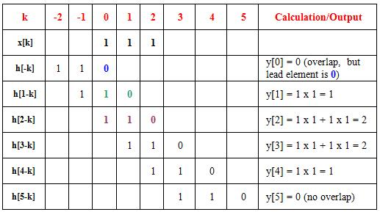
Convolution using Tabular Method

